Slide 1

Jasa Marketing via Online

Slide 2
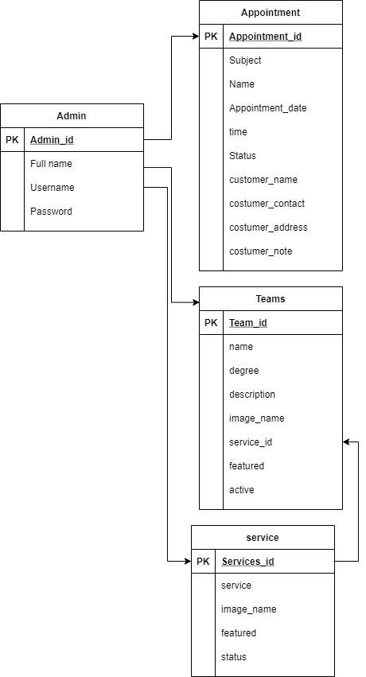
UML

Slide 3
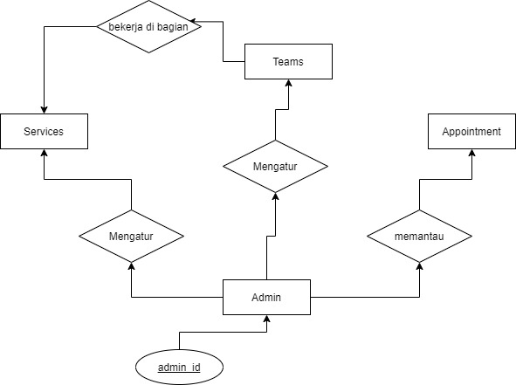
ERD

Slide 4

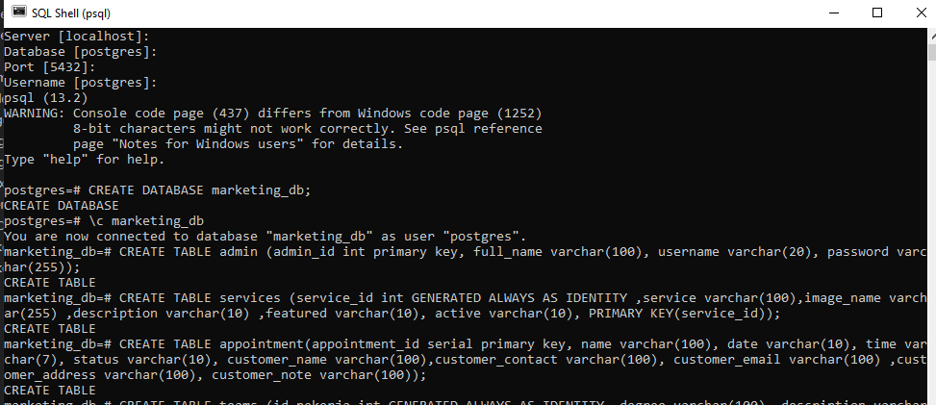
Postgresql

Slide 5
Flowchart

